Slide 1
RUM Community Group
2025-06-20 Edition

Slide 2
Agenda
Logistics
Next Meeting
Agenda
Barry's Bytes (fetchLater, web-vitals v5?) (Barry Pollard) + Soft Navs (Michal Mocny)
Firefox interactionId (Nazim Can Altinova)
Unresponsive crash reports, Self Profiling (Issac Gerges)

Slide 3
Logistics
Meeting cadence
2nd Friday of the Month
60 minutes
10am ET
Agenda Document
(bit.ly/rumcg-agenda)
Google Meet for Meetings
sub to rumcg-participants for invites
Chat on Web Performance Slack #w3c-rum-community-group
(invites)
public-rumcg@w3.org
(for discussions)
RUM CG Github Repo
github.com/w3c-cg/rum
Group details
Links
Meeting minutes?
RUM CG Tracking Project
github.com/orgs/w3c-cg/projects/1
Meeting Minutes via fireflies.ai (NEW)
AI summary + transcript will be posted after
Full video recording also available

Slide 4
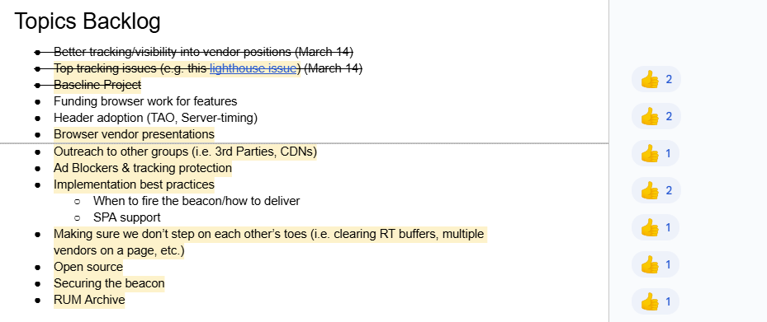
Next Meeting
Fri August ??th @ 10am EST
2nd Friday of each month
Topics?
Implementation best practices
(propose your topic here!)
Submit & Vote topics @ bit.ly/rumcg-agenda

Slide 5


Slide 6
What’s new in WebPerf from Google
Soft Navs - Michael covering
FetchLater and quotas
web-vitals v5 and some thoughts on how to use LoAF
Speculation Rules improvements
Compression Dictionary Transport

Slide 7
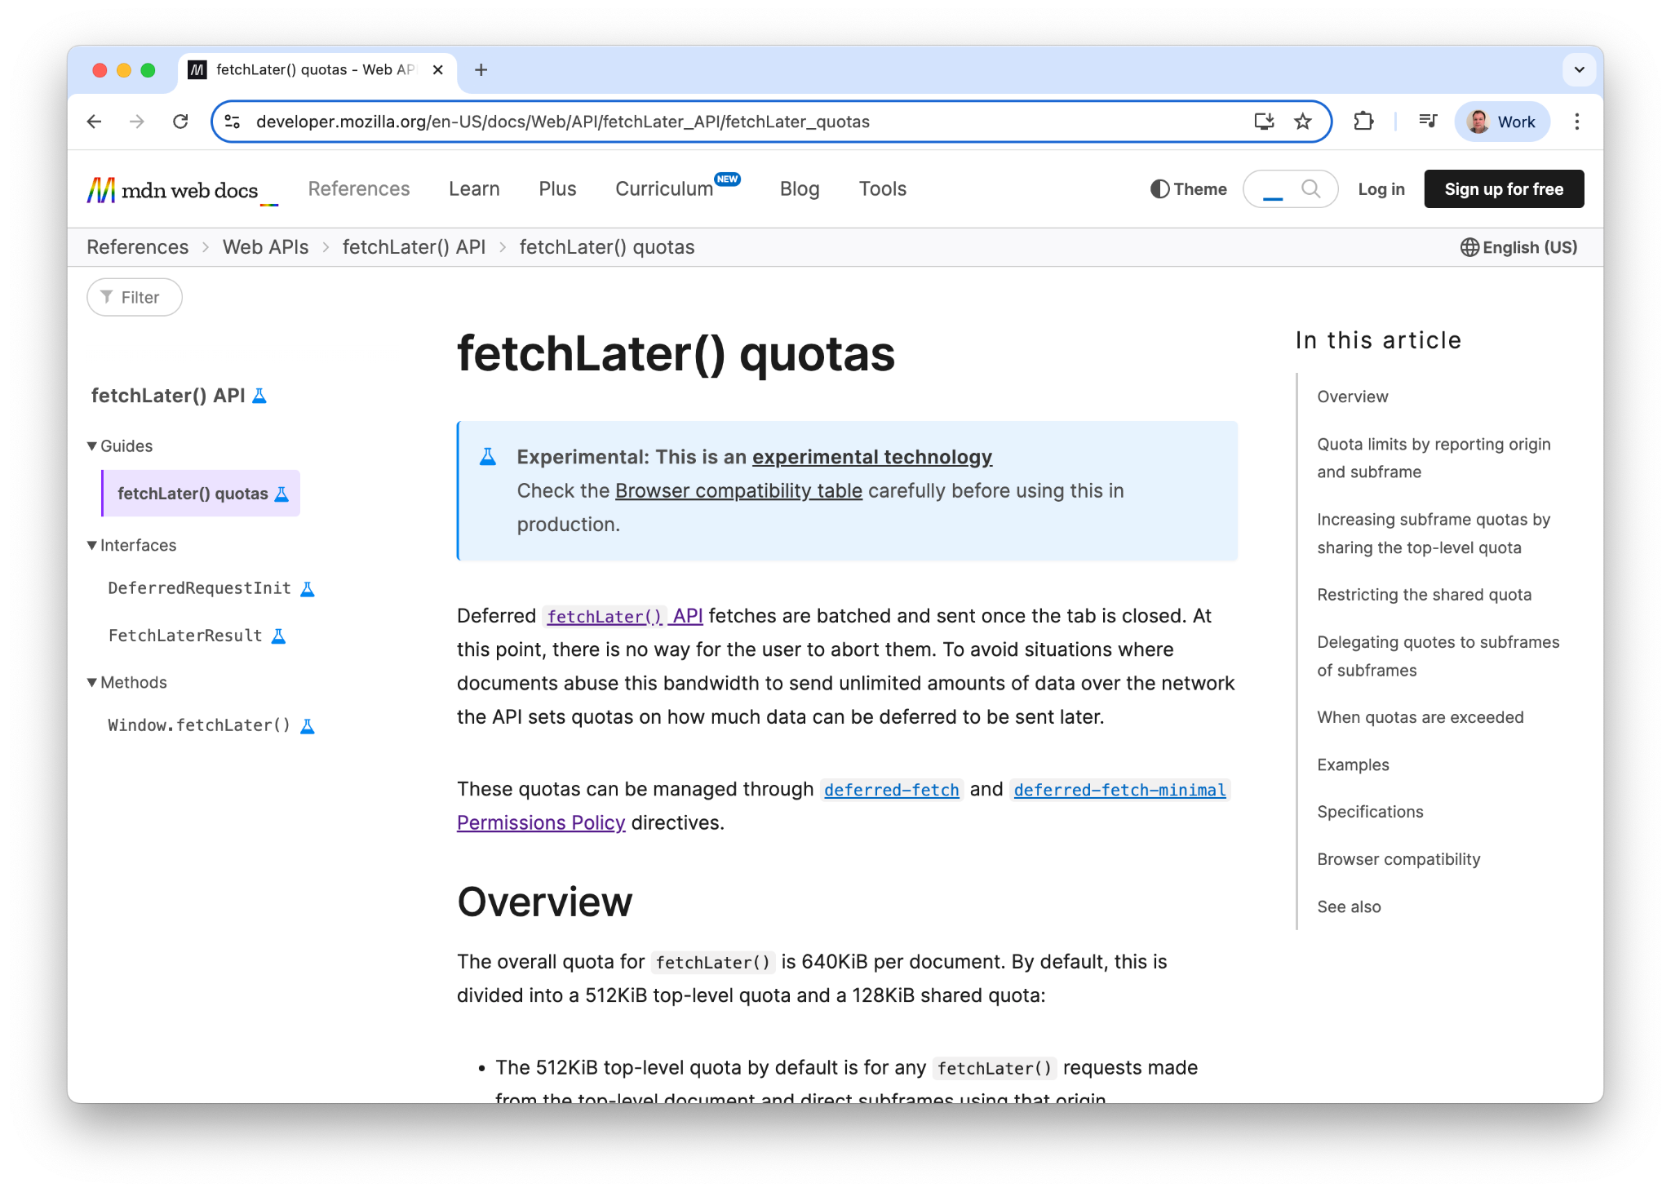
FetchLater and quotas
FetchLater has strict quotas
Sometimes this hits in unexpected ways (crbug.com/410528357)
Check it and prepare to fallback
Read the docs

Slide 8
web-vitals v5
Only maintained branch going forward
onFID() has been removed
We use Baseline Widely available for code and builds
Improved LoAF attribution (covering in next slides)
Saves element targets when performance observers fire, even if not reported until later (less unknown targets)
Custom element selector if needed
Memory and event handlers improvements

Slide 9
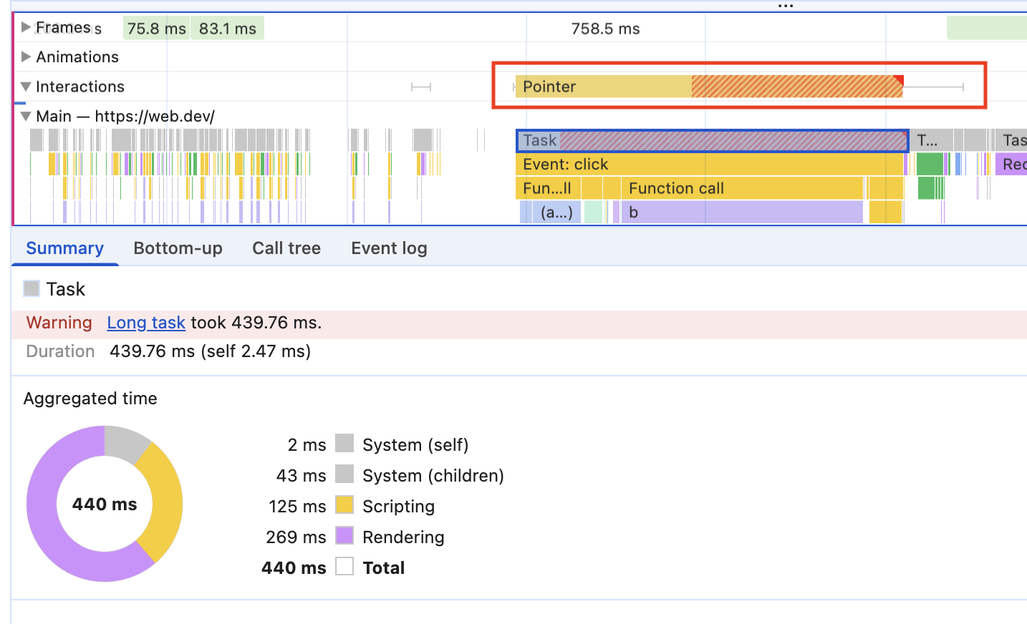
web-vitals v5 - improved LoAF attribution

Slide 10
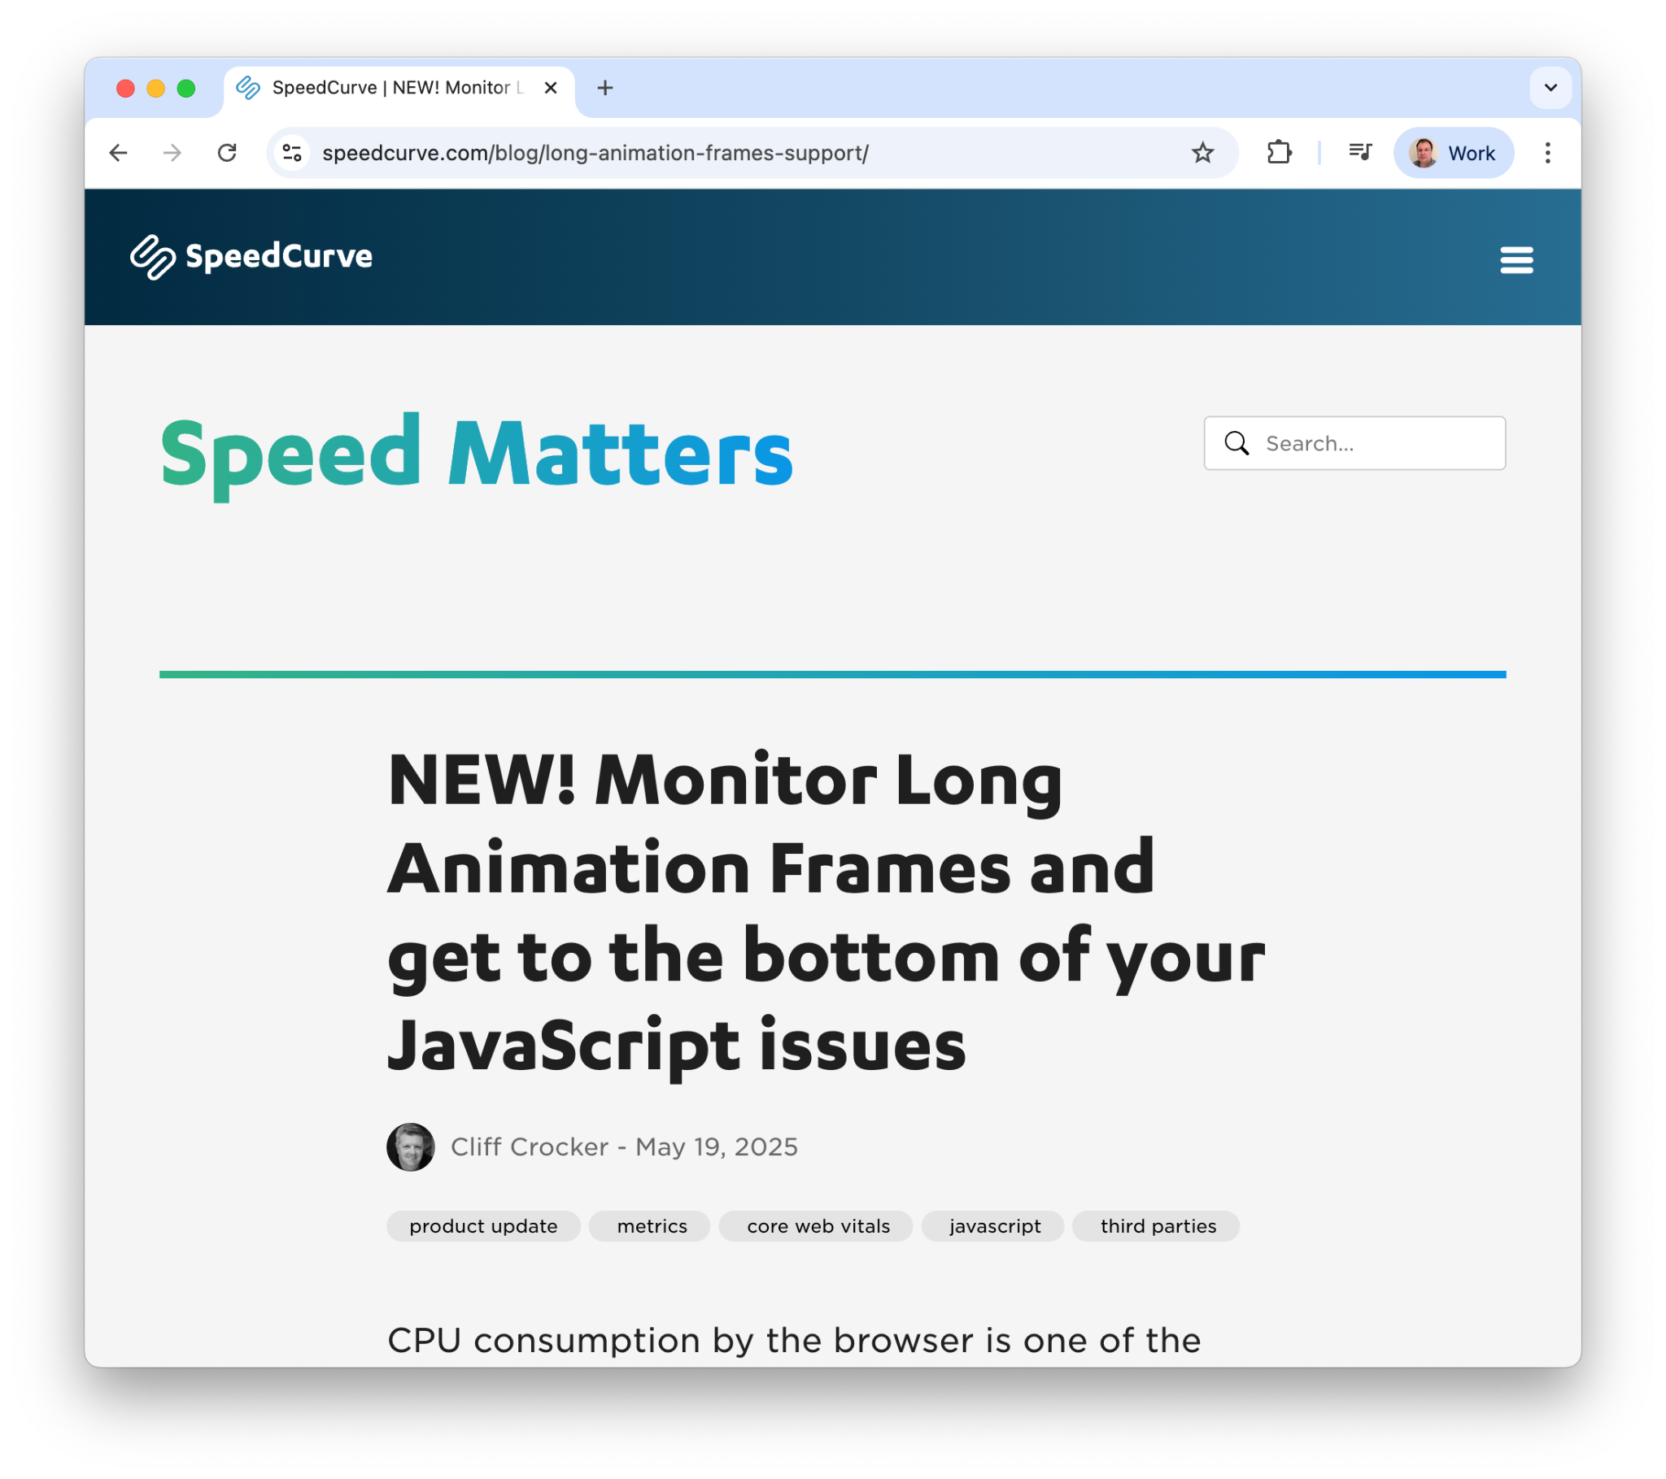
web-vitals v5 - improved LoAF attribution
LoAF contains a LOT of data
Can beacon it all
Speed Curve does this
But that’s a lot to beacon
Can beacon a sampling of users
But miss stuff
Can beacon only some stuff
E.g. longest script
We wanted to look more at the last option for web-vitals v5

Slide 11
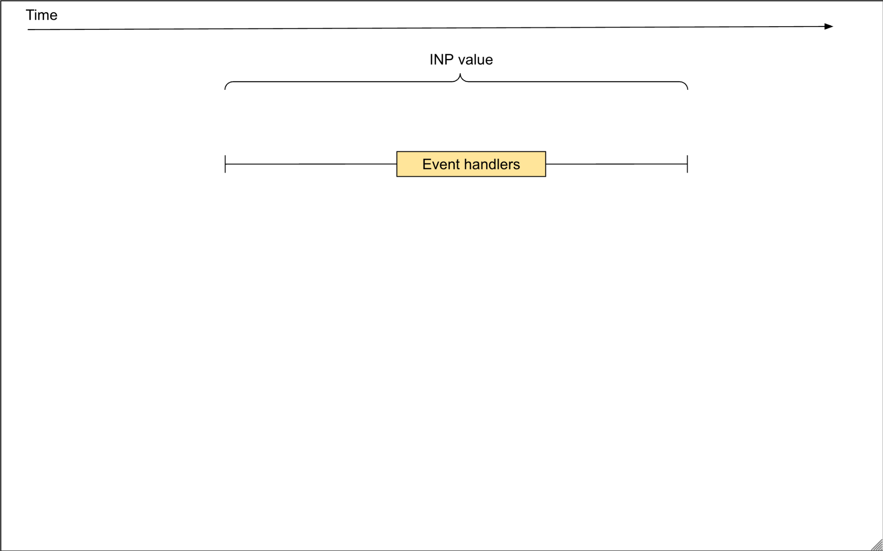

Slide 12
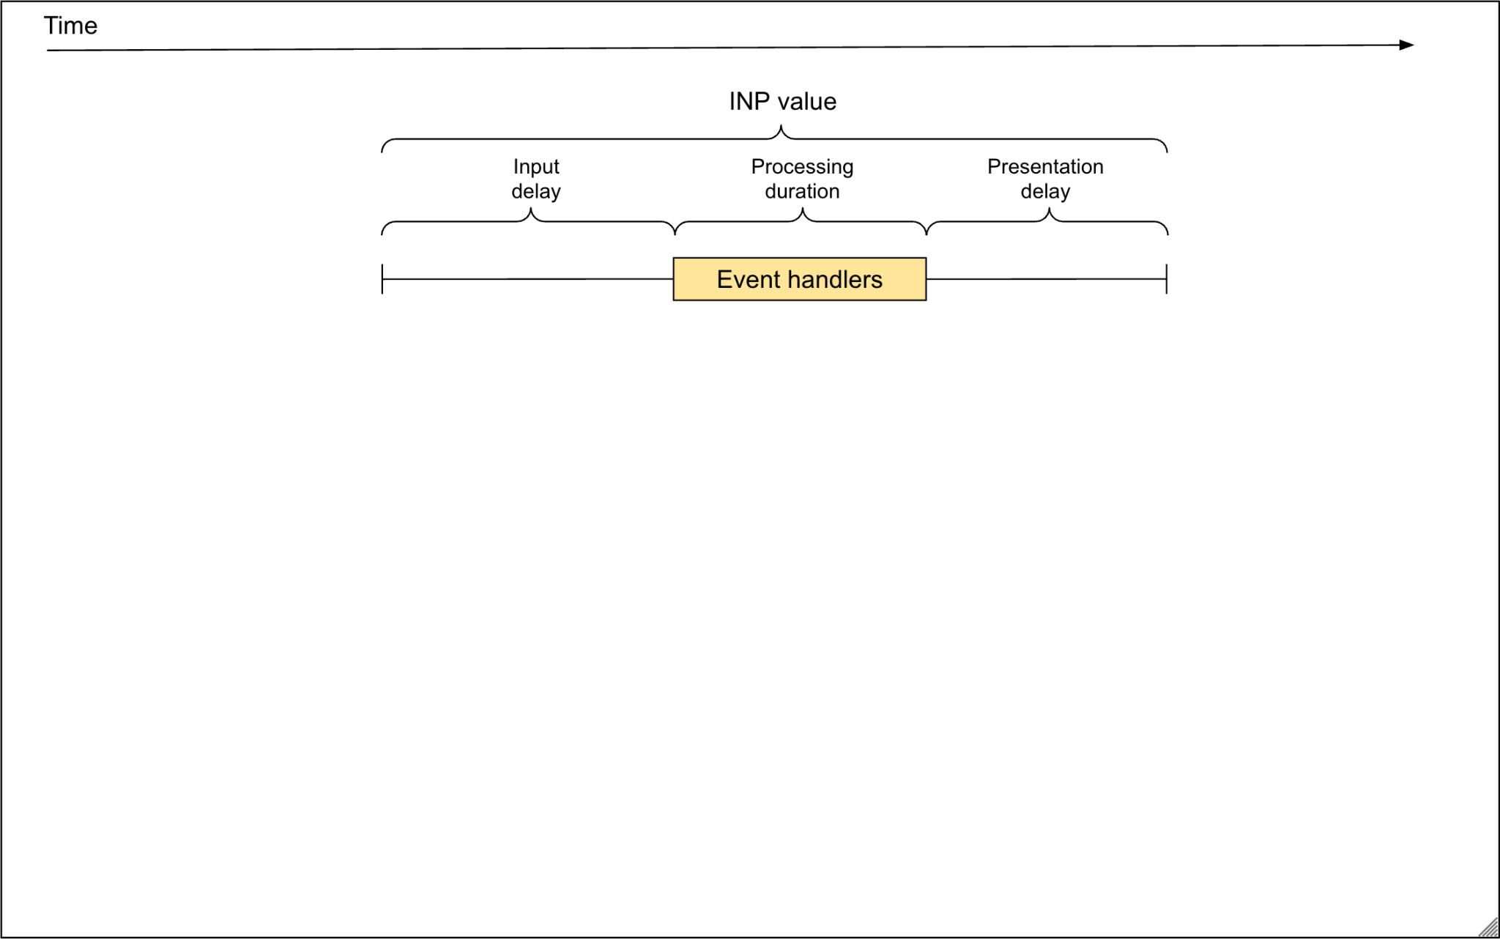

Slide 13
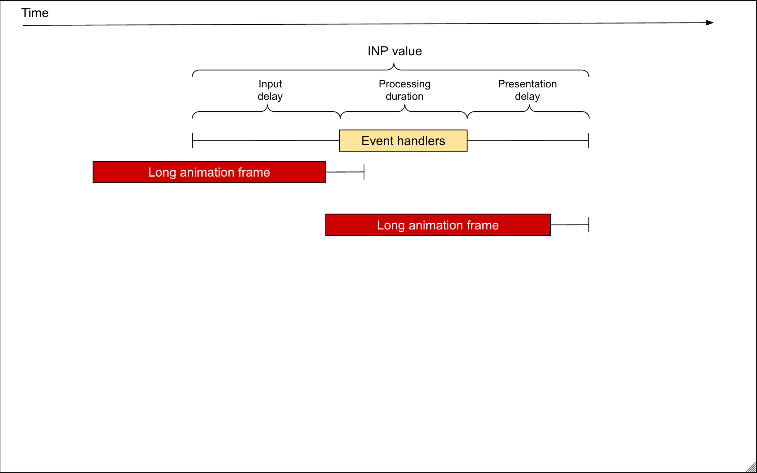

Slide 14
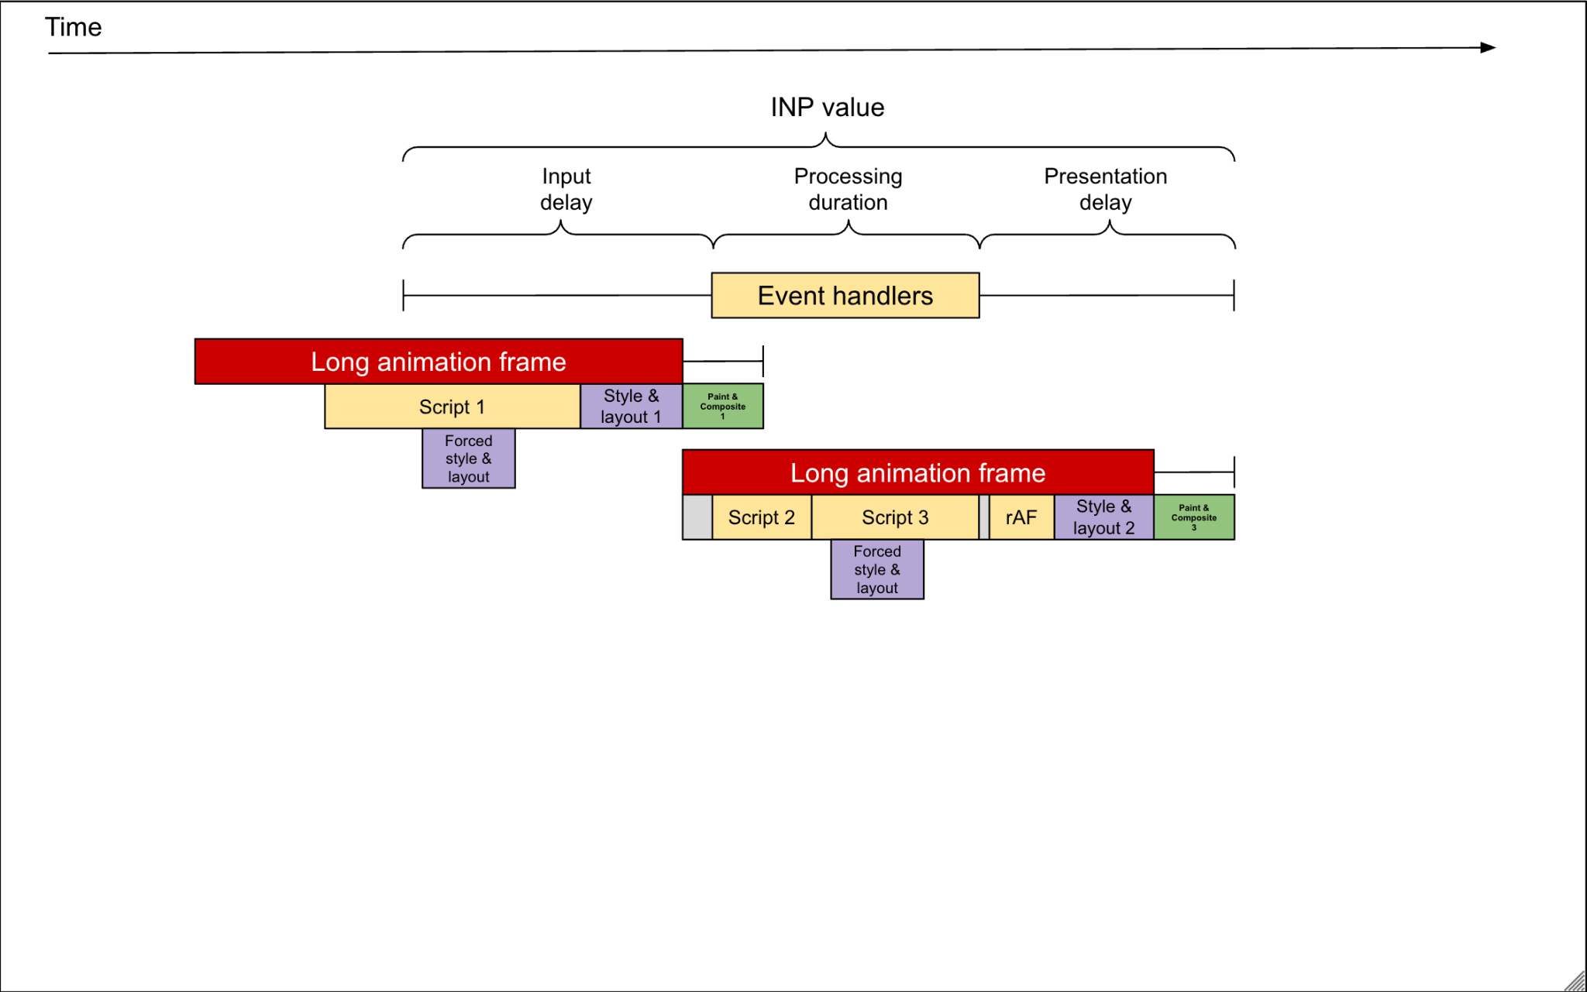

Slide 15
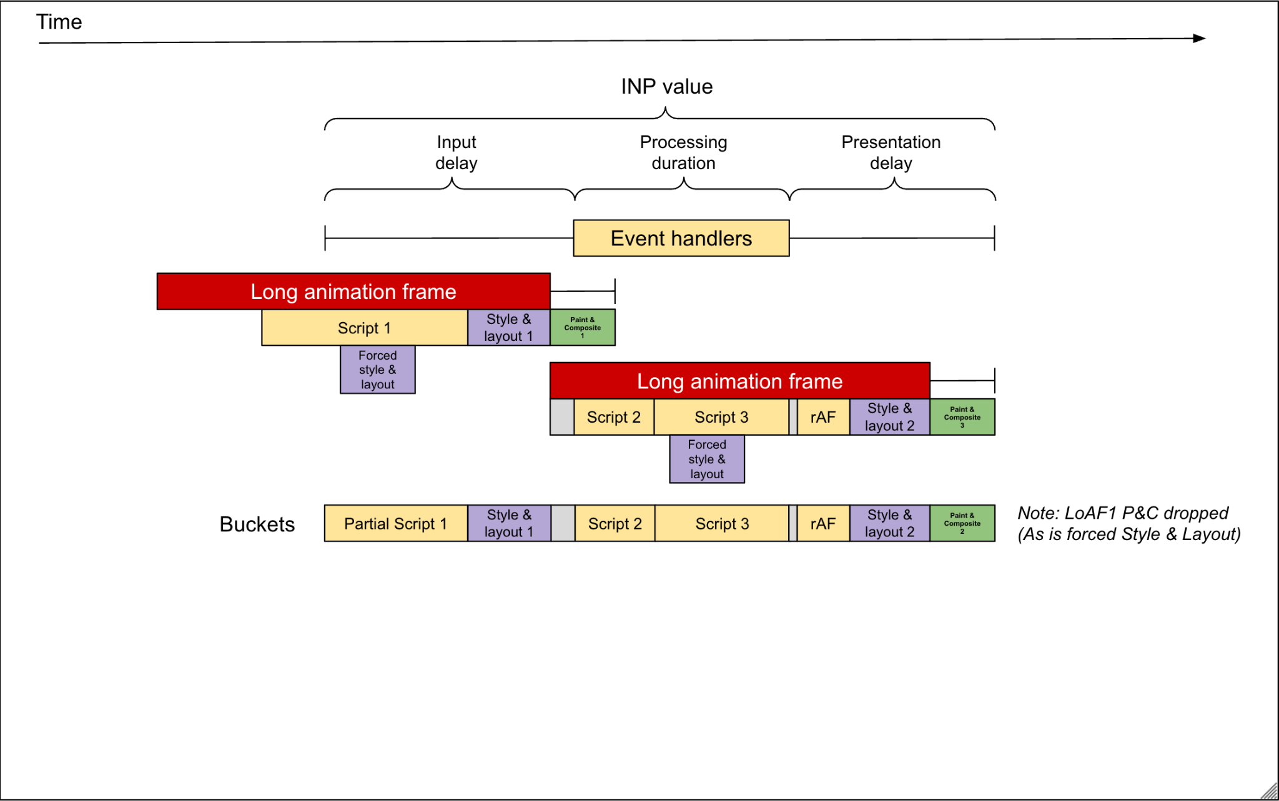

Slide 16
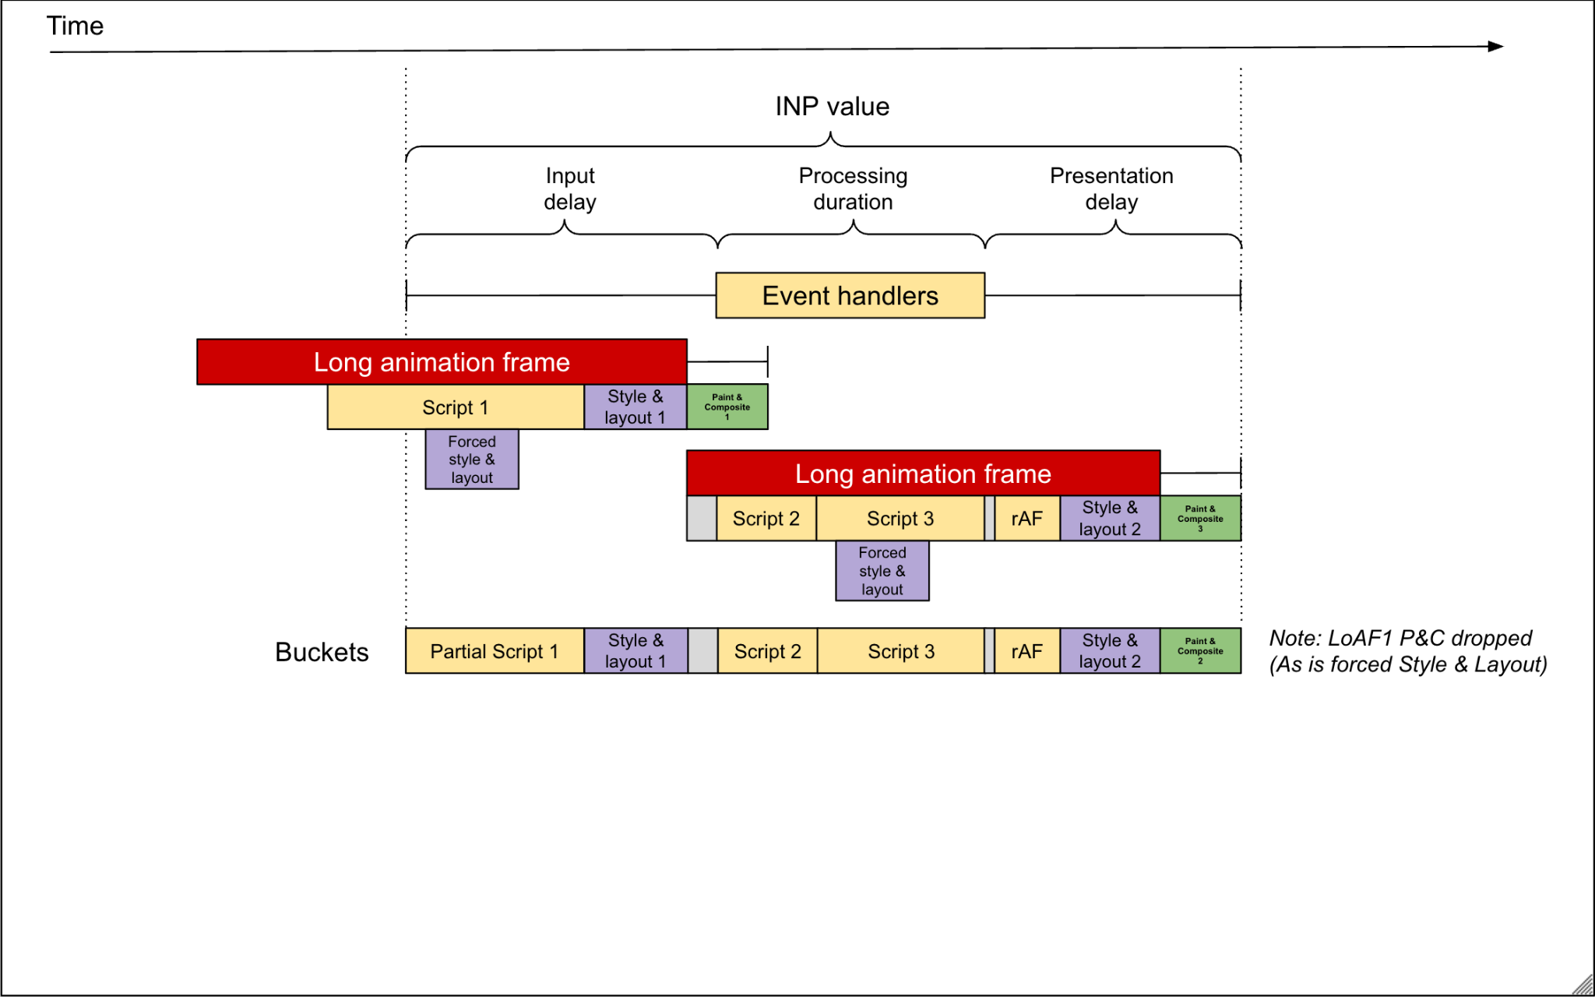

Slide 17
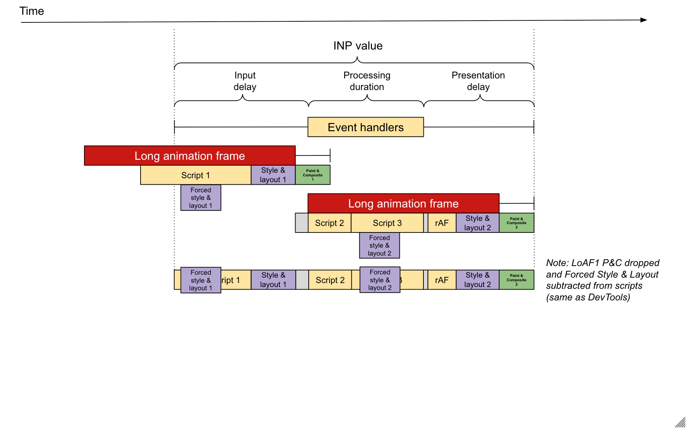

Slide 18
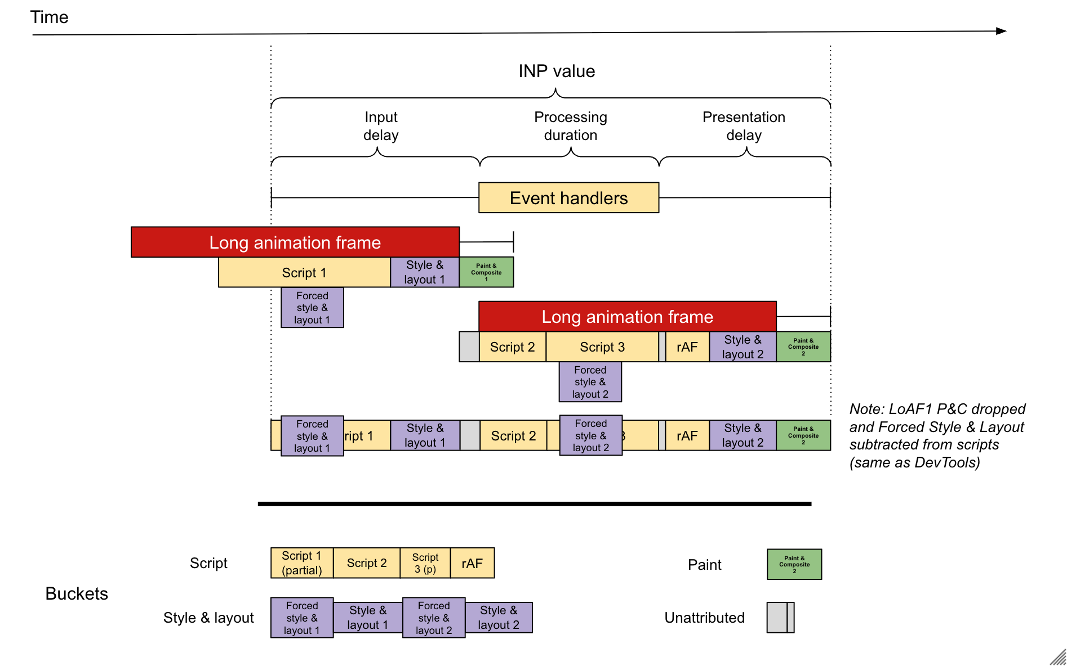

Slide 19
Longest script may not be the longest overlapping script!

Slide 20
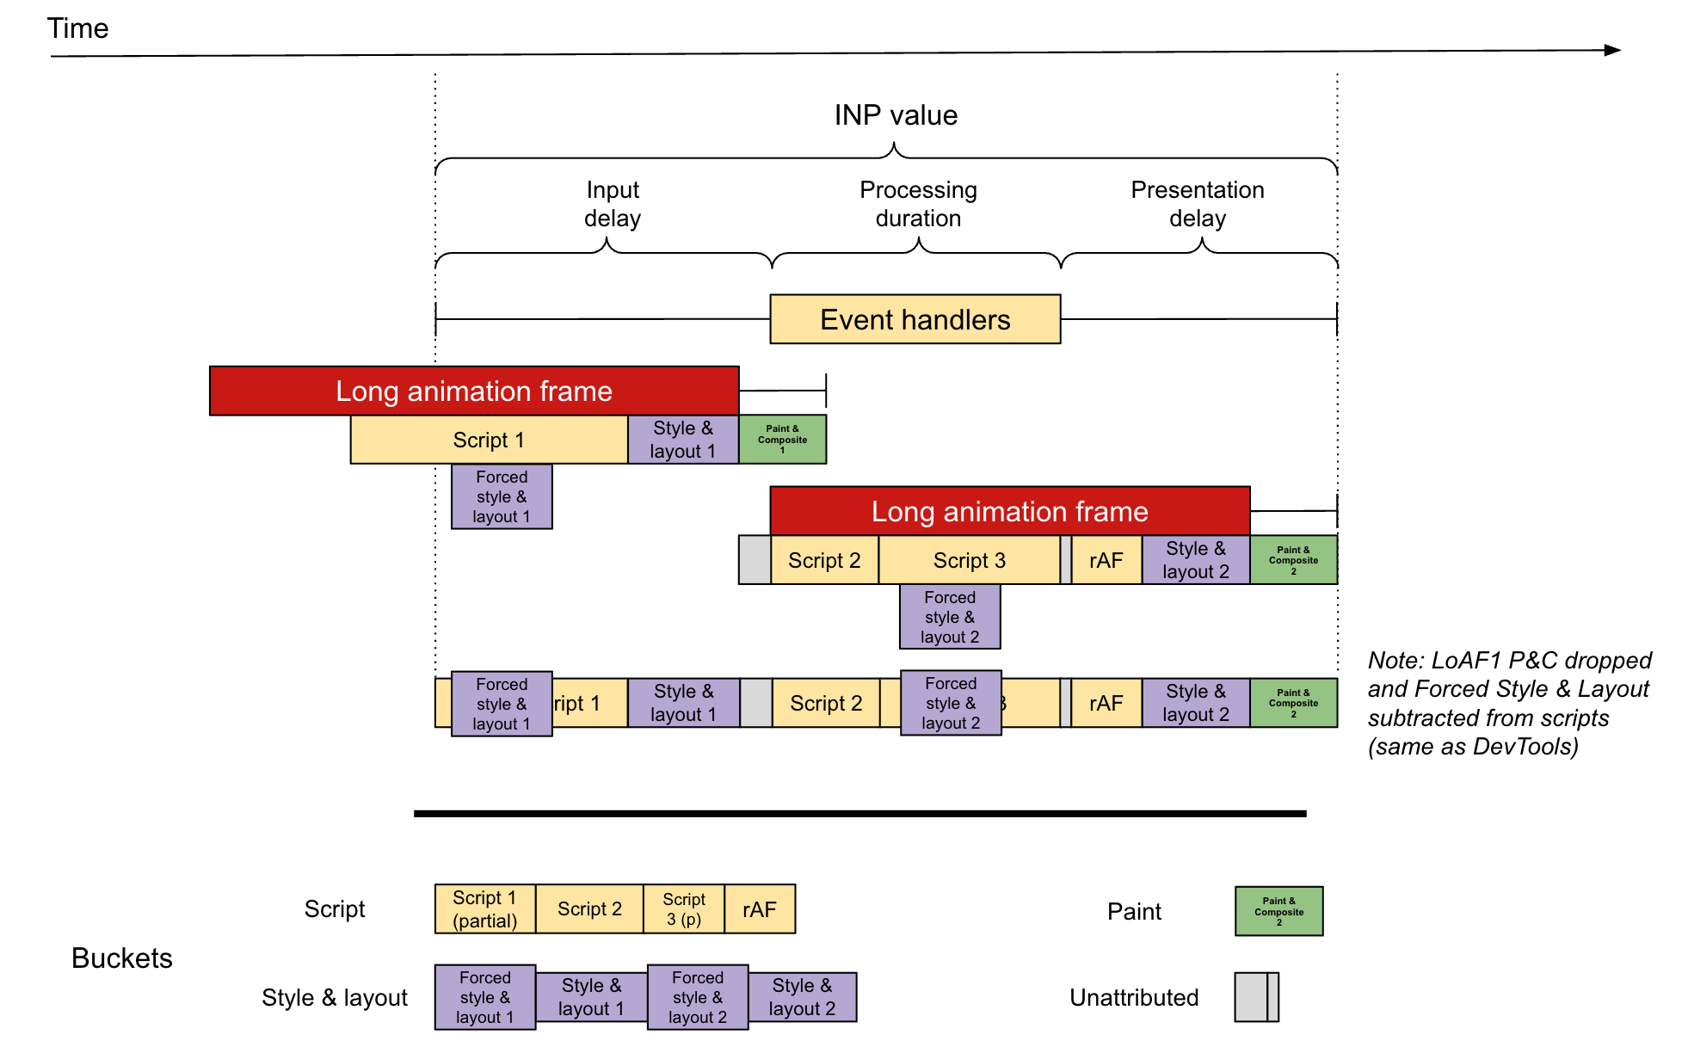
web-vitals v5 - improved LoAF attribution
Longest intersecting script and buckets

Slide 21
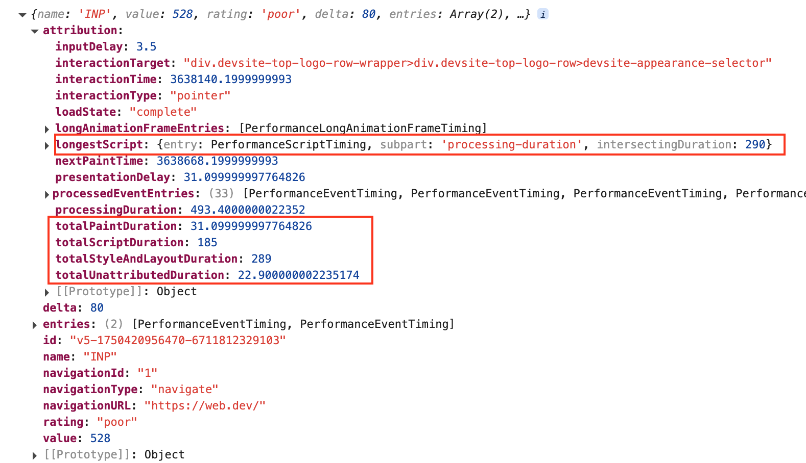
web-vitals v5 - improved LoAF attribution
Longest intersecting script and buckets

Slide 22
Speculation Rules improvements
Large platform roll outs
WordPress 6.8 - On by default - conservative prefetch - 30/45% of websites
Shopify - On by default - conservative prefetch - 5% of the web
Cloudflare - working on re-enabling by default - 10% of home pages

Slide 23
Speculation Rules improvements
Large platform roll outs
WordPress 6.8 - On by default - conservative prefetch - 30/45% of websites
Shopify - On by default - conservative prefetch - 5% of the web
Cloudflare - working on re-enabling by default - 10% of home pages
New features
136 - tag field
138 - target_hint field
138 - Clear-Site-Data header: prefetchCache and prerenderCache
138 - ServiceWorker support for prefetch (currently at 50%)
138 - Viewport heuristics for mobile for moderate
140? - Viewport heuristics for mobile for eager

Slide 24
Speculation Rules improvements
Large platform roll outs
WordPress 6.8 - On by default - conservative prefetch - 30/45% of websites
Shopify - On by default - conservative prefetch - 5% of the web
Cloudflare - working on re-enabling by default - 10% of home pages
New features
136 - tag field
138 - target_hint field
138 - Clear-Site-Data header: prefetchCache and prerenderCache
138 - ServiceWorker support for prefetch (currently at 50%)
138 - Viewport heuristics for mobile for moderate
140? - Viewport heuristics for mobile for eager
More browser support coming?
Mozilla working on it for prefetch for Firefox - https://bugzilla.mozilla.org/show_bug.cgi?id=1969396
Safari positive on subset - https://github.com/WebKit/standards-positions/issues/54/

Slide 25
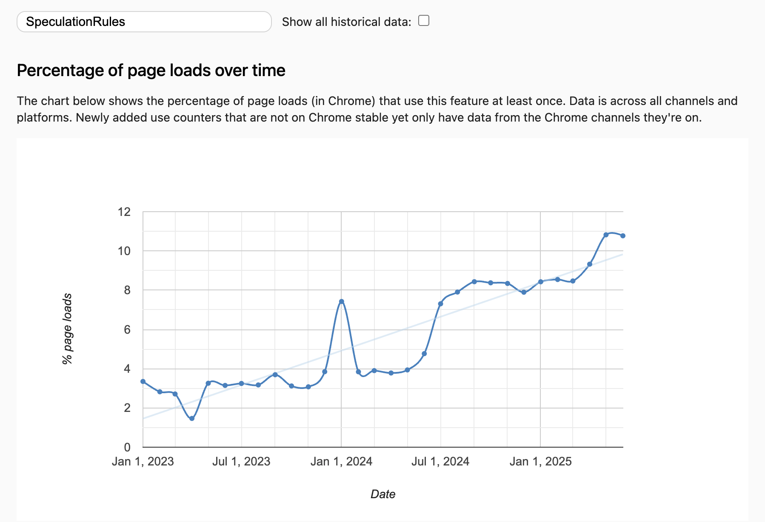
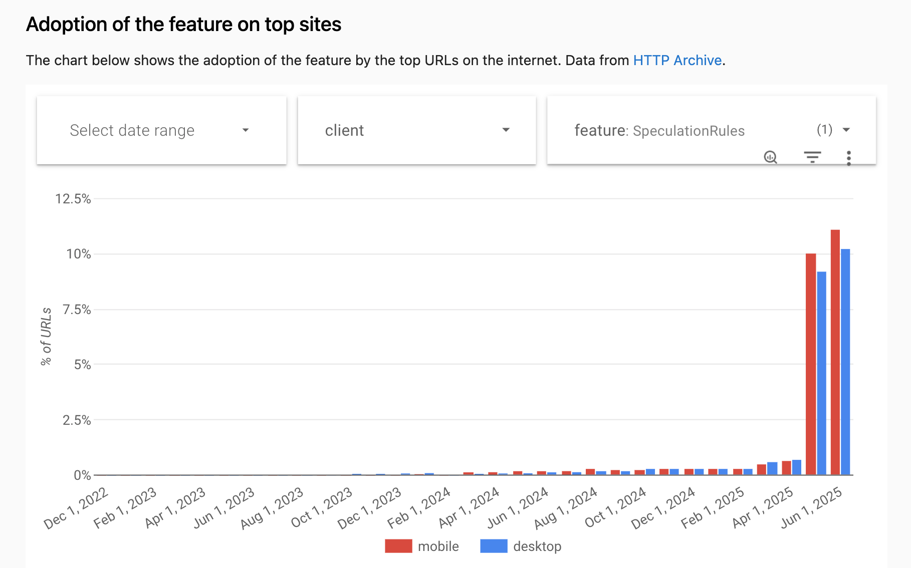
Speculation Rules adoption
https://chromestatus.com/metrics/feature/timeline/popularity/3932

Slide 26
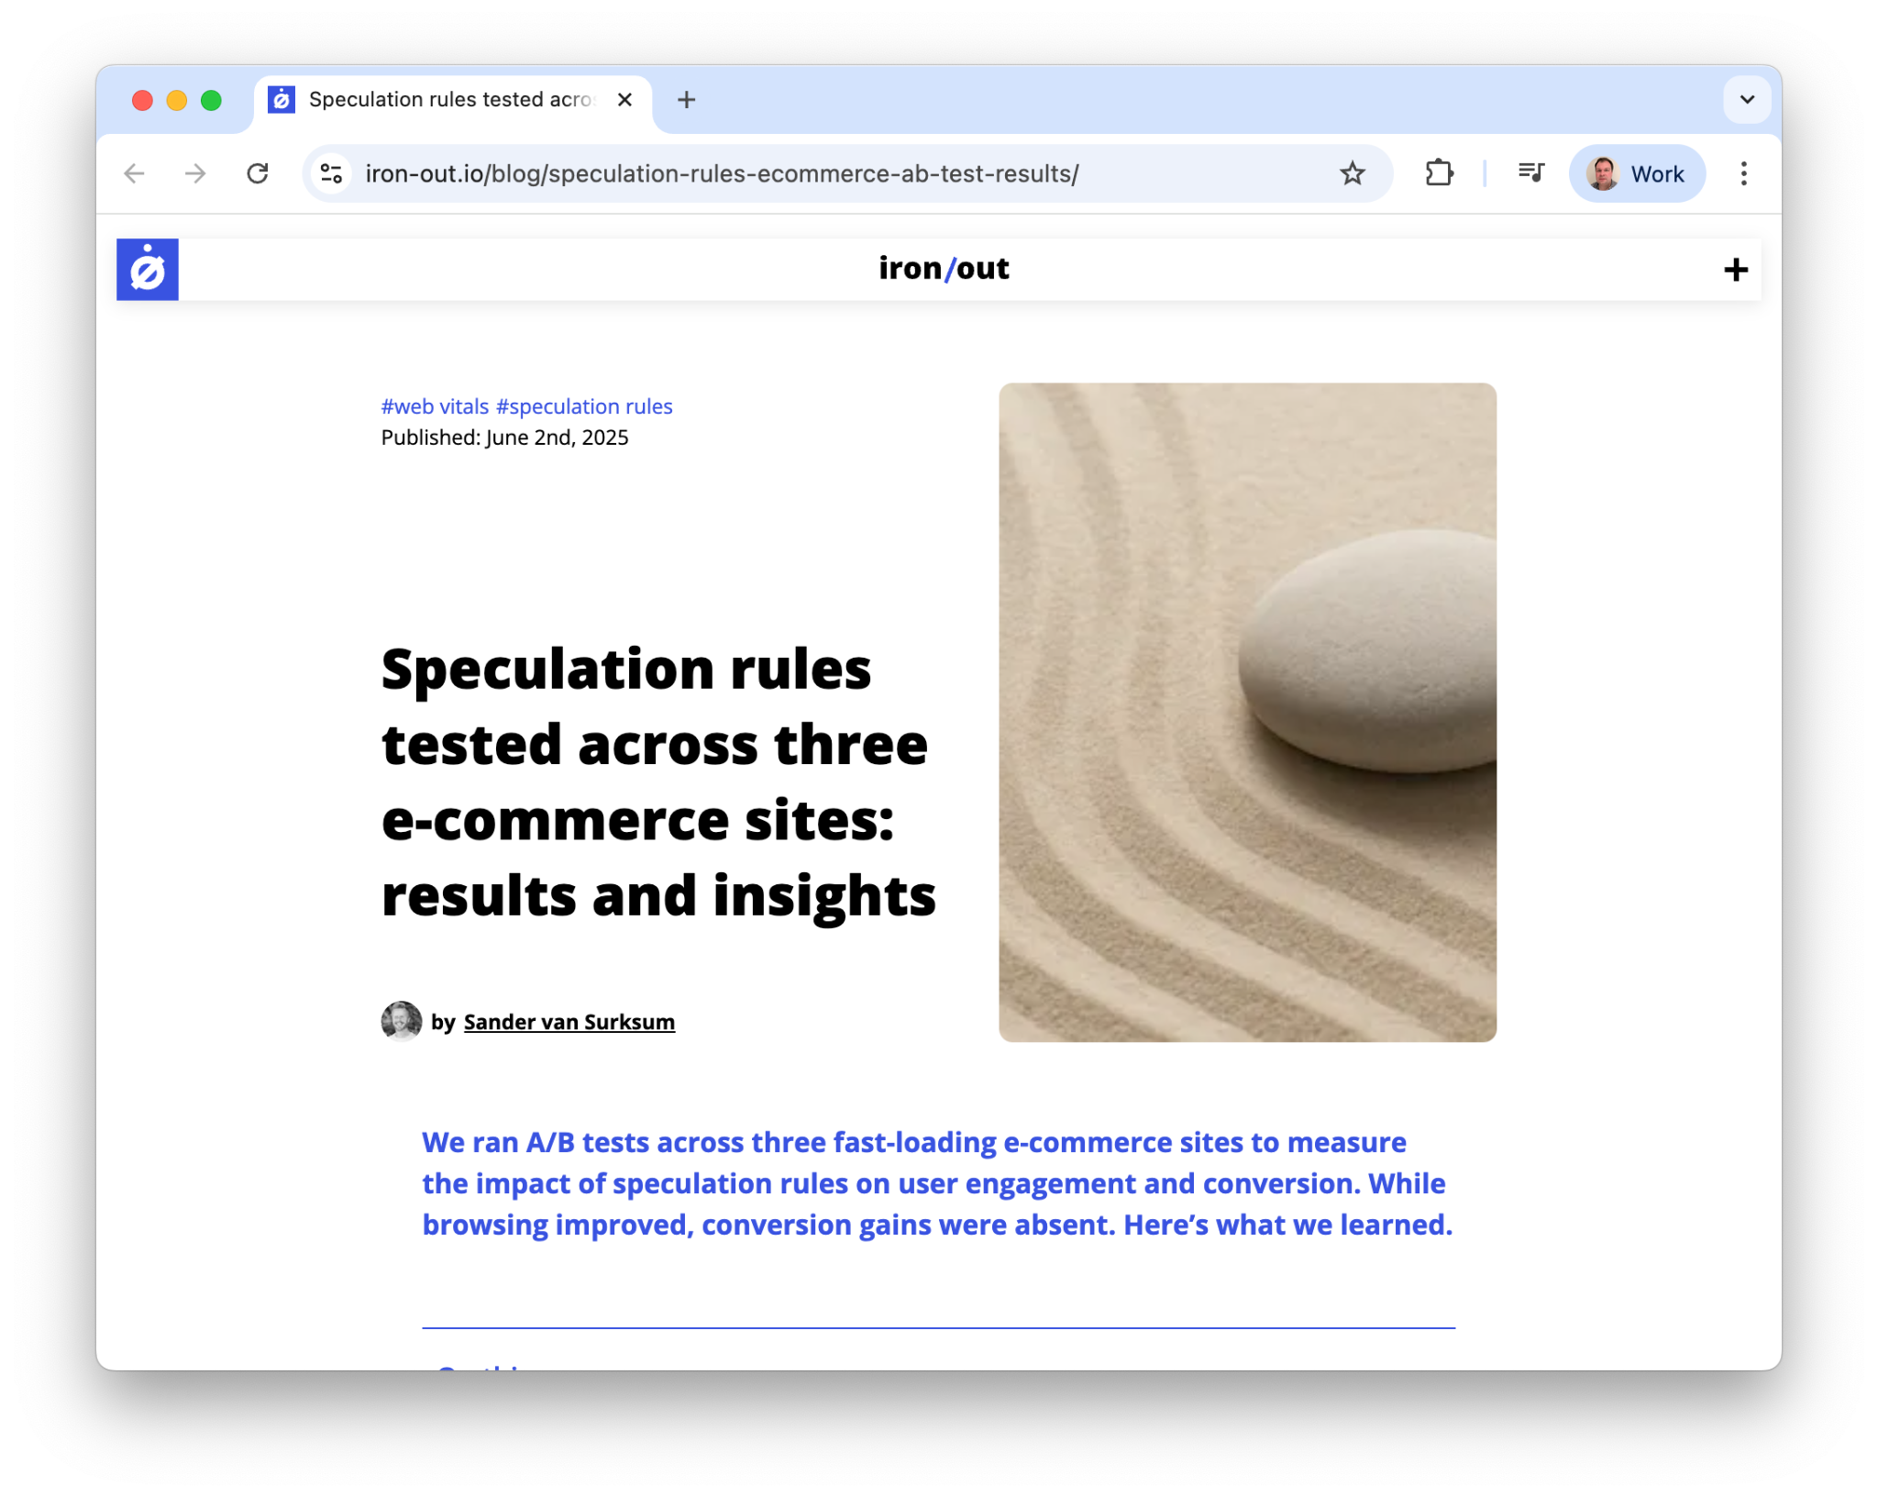
Speculation Rules - measure it in RUM!!

Slide 27
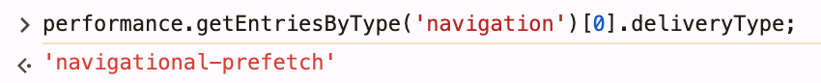
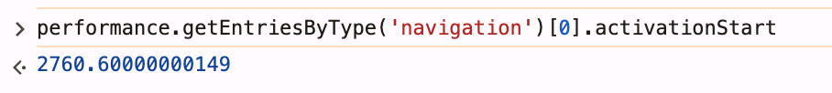
Detect Speculations: client-side
Prefetch - deliveryType:
Prerender - non-zero activationStart:

Slide 28
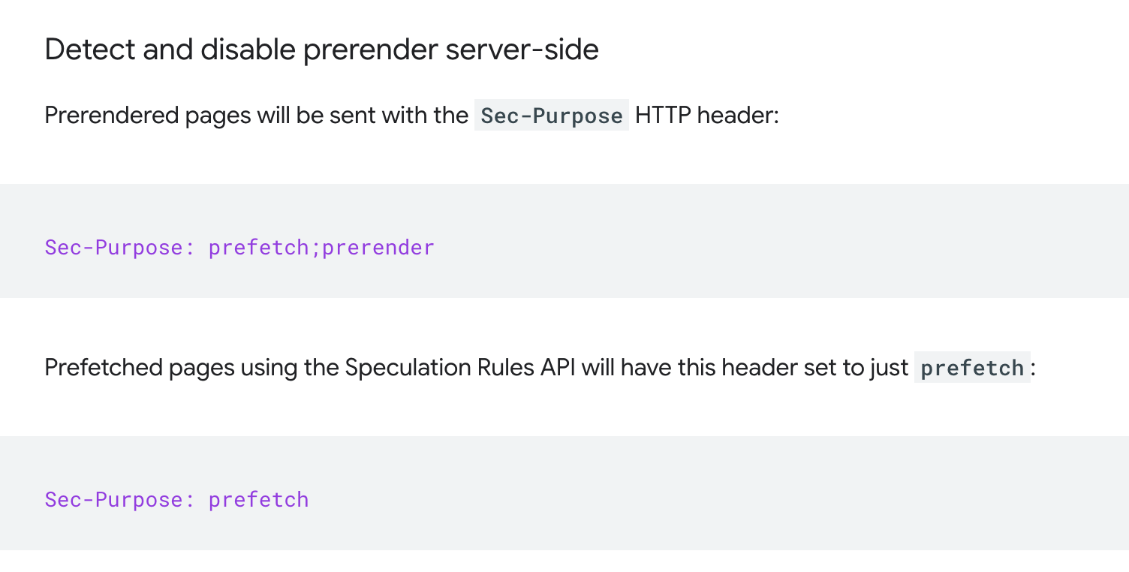
Detect Speculations: server-side
https://developer.chrome.com/docs/web-platform/prerender-pages#detect-server-side

Slide 29
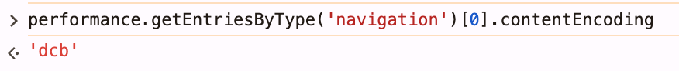
Compression Transport Dictionary
Being heavily used by Google
Ads/DoubleClick
Google Search
Case study:
https://developer.chrome.com/blog/search-compression-dictionaries
Know of several companies looking into this technology
Usage is likely to increase!
Detecting dcb/dcz client-side:

Slide 30
Thank you!
Reach out:
@tunetheweb on most socials
barrypollard@google.com

